Slide 1





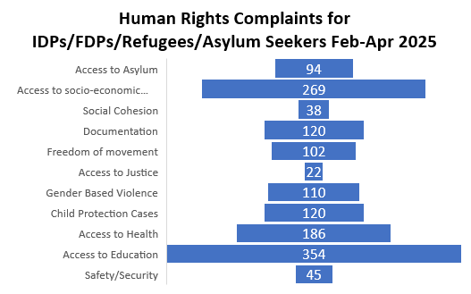
NHRC Dashboard on Human Rights & Internal Displacement
February - April 2025
Bob Attacks
Displacements
Households
Children
REFUGEES/ASYLUM SEEKERS
3
2
44,295
5,953
20,648
7,401
DESTRUCTION OF PROPERTIES
Gombe
Anambra
POLITICAL INTOLERANCE
Destruction/Cutting of Roads
Stoning of Governor Buni at APC Rally
Cancellation of PDP Rally
Kidnappings
POLITICAL VIOLENCE
Attack on NNPP Supporters
Attack on First Lady’s convoy
Attack on PDP Campaign DG
Attack on LP HOR Candidate
Attack on LP Supporters
Attack on Wife of PDP Candidate
briefs@nhrc.gov.ng

